Slide 1
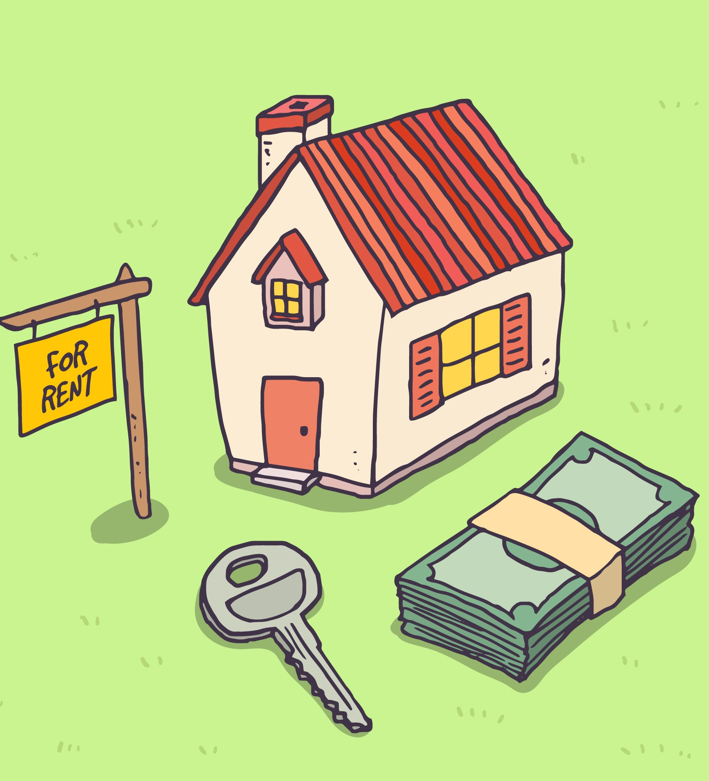
Welcome To House Rent Management System
Name : Jahid Ahmed
Id : 1285265
Batch : JEE/NCLC-m/62/01
Round : 62

Slide 2
PROJECT OVERVIEW
Platform Overview:
The House Rent Management System is a comprehensive web-based platform.
Purpose:
Its goal is to eliminate the hassle of finding a rental home and also digitally solve the problems of tenants and landlords..
Business Scope: User can buy Packages and add credit balance to their account with lifetime validity. Every user can Add their property & Per add charges 10 credit for every single post. Also user can view which are available for rent and unlock all details by the charge of 5 credit. The credit will be refundable if the property has already been rented, which means the homeowner has not yet updated the current status of their home.
Core Functionalities:
The platform provides seamless features for:
Every user have credit balance.
Add Property for Rent by using credit.
Unlock & Viewed Property by using credit.
Buy Subscription Packages
Save Property in Favorite .

Slide 3
Technologies Use
Frontend:
Node.js (version: 22.14.0)
Angular (version: 19)
Bootstrap (version: 5.3)
Backend:
Java (JDK 21)
Spring Boot
Spring Data JPA.
Spring Security etc.
Database Layer:
Oracle SQL (version: 19c)
File Storage:
Supported files: JPGE, JPG, PNG
Local Server Storage.

Slide 4
Core Functional Modules:
A. User Authentication & Role Management:
Registration & Login (with email verification).
Roles: Admin, General User (Their can play both role as house owner and tenant).
Permissions defined per module based on user type and their specific functionality.

Slide 5
Core Functional Modules:
B. Admin Panel:
Manage users, roles, permissions.
Create and manage credit packages.
Manage user activity, their listing and Suspension .
Monitoring User, Pages, Listing and other with Overview dashboard.
Verify the refundable credit

Slide 6
Core Functional Modules:
C. Public see in Website (User Frontend):
User can see available property for Rent and also add their property.
User can search their rental destination by their specific requirement as Family, Sublet, Bachelor, Roommate, etc.
User save property in favorite list.
User registration for profile creation and login.
Search functionality by Property Id, Category, Location, etc.

Slide 7
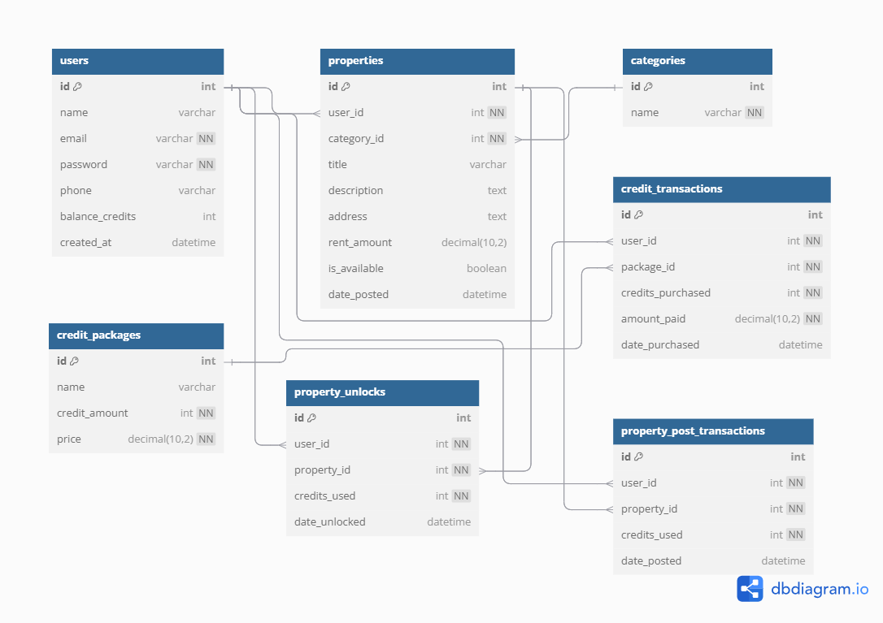
Entity Relationship Diagram (ERD)
Name of Tables:
Users
Properties
Categories
Property Unlock
Property Post Transaction
Credit Transaction
Credit Package
Link: Diagram Web Link

Slide 8
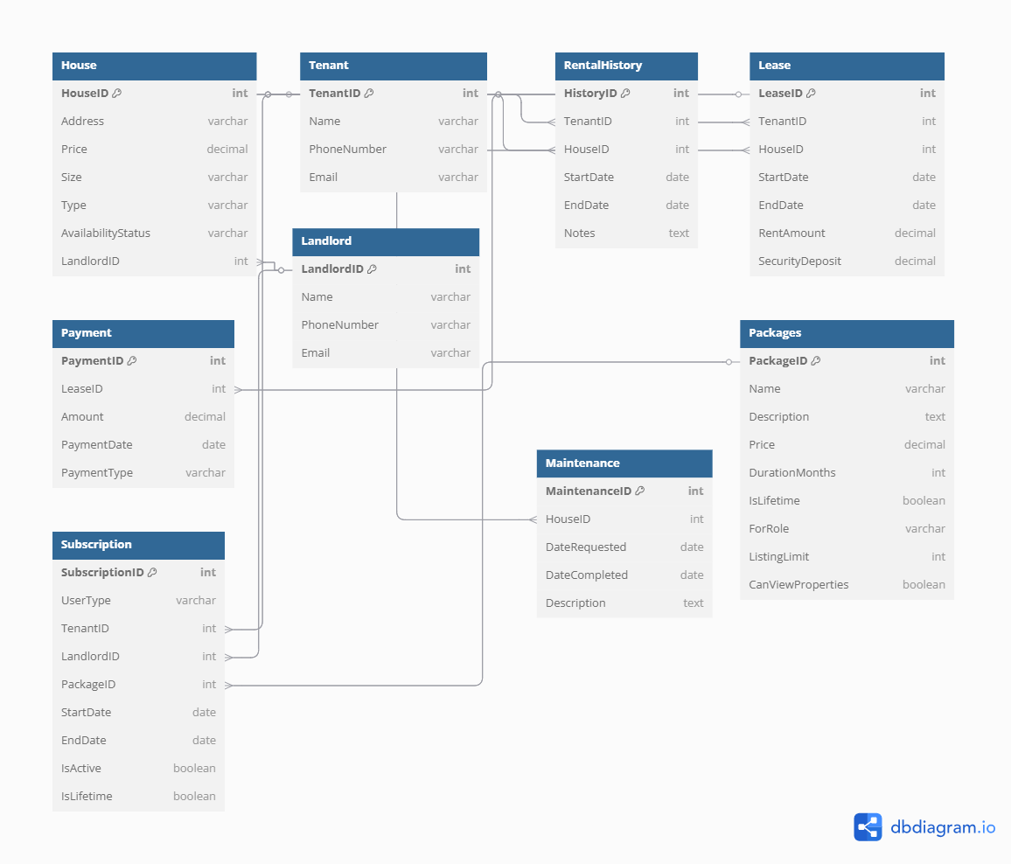
In Future Upgrading (ERD)
Name of Tables:
House
Tenant
Rental History
Lease
Landlord
Maintenance
Payment
Packages
Subscription
Link: https://dbdiagram.io/d/6806d0a11ca52373f5cc3f3d

